Slide 1
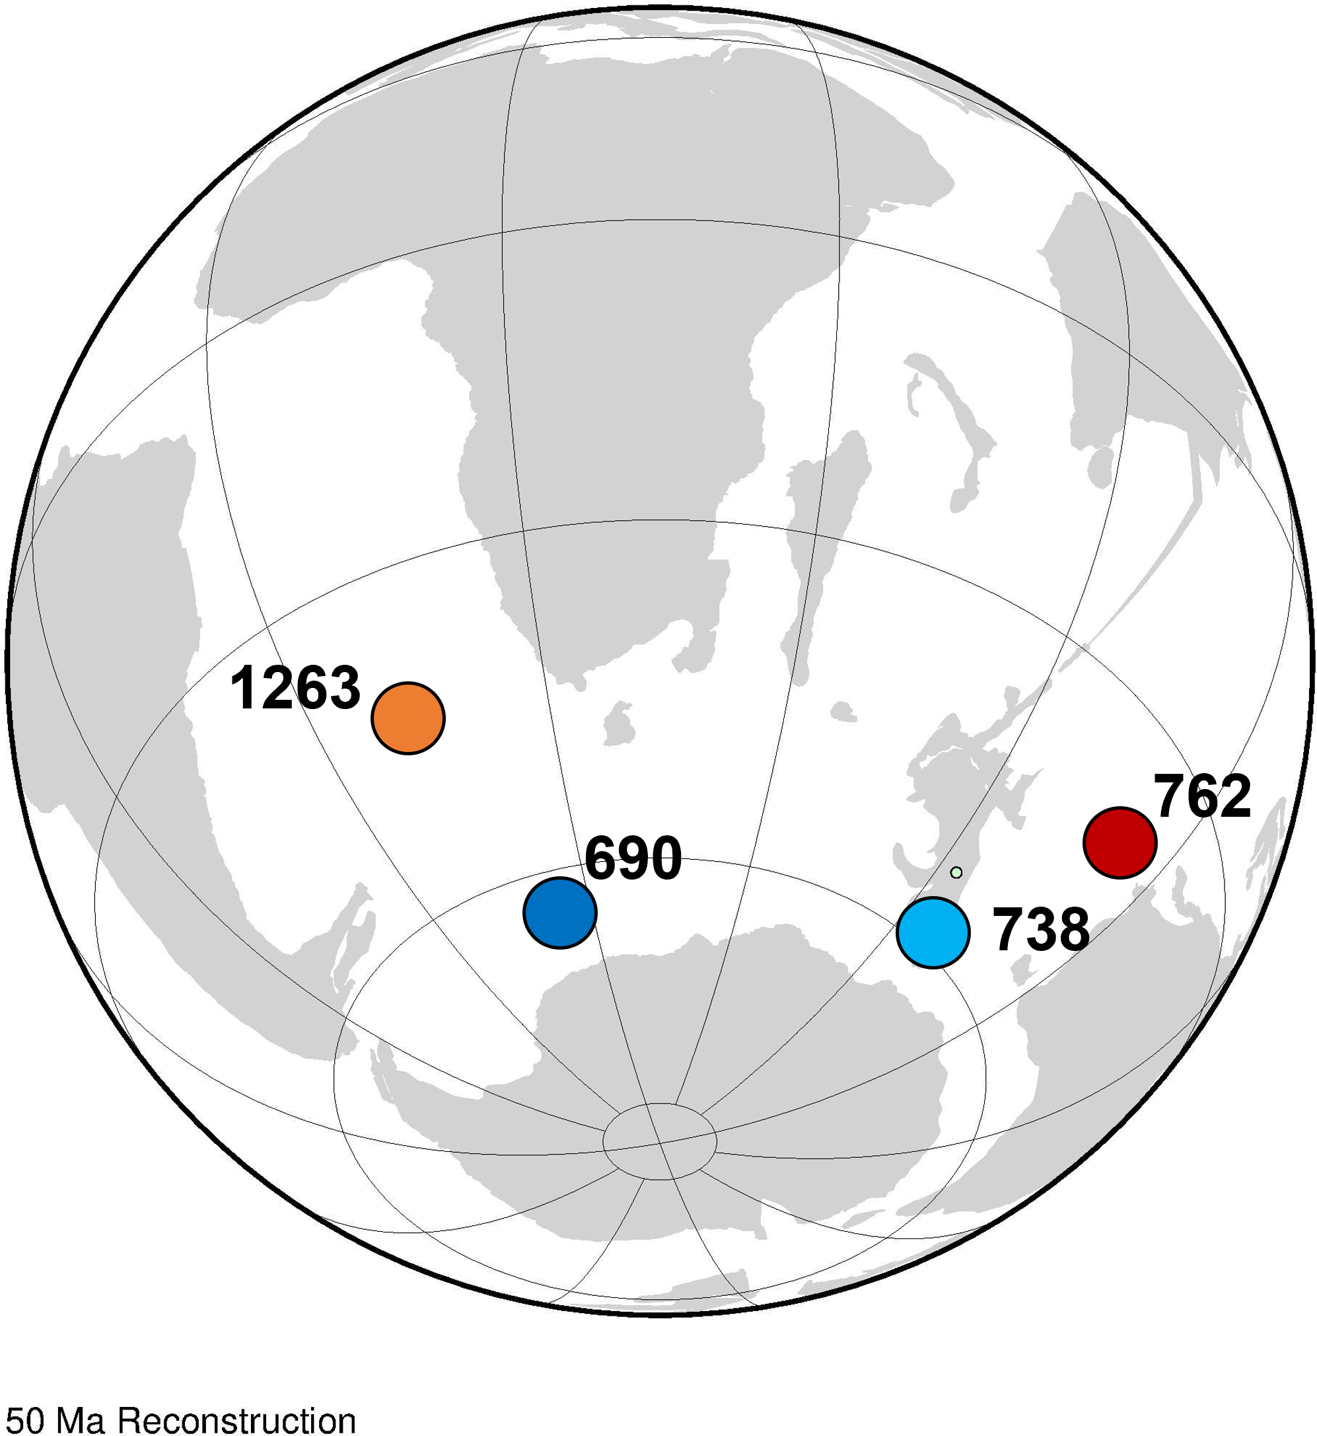
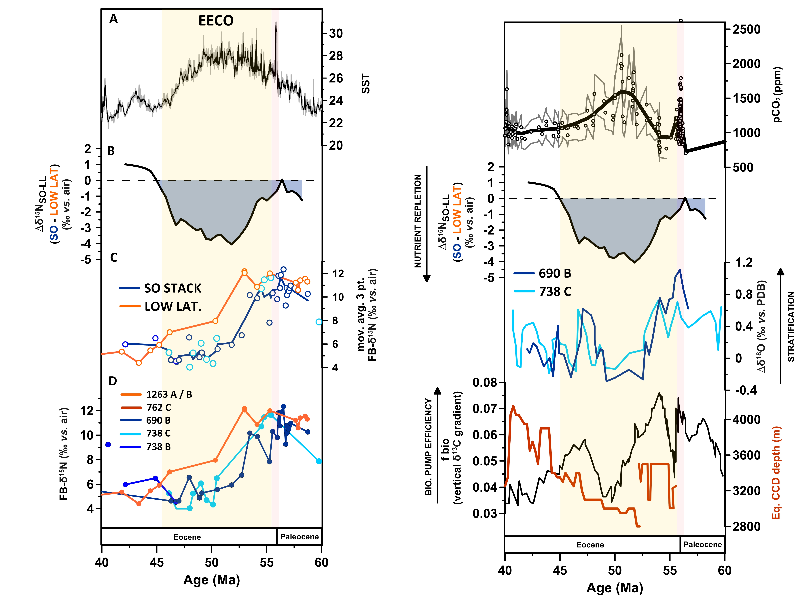

Slide 2
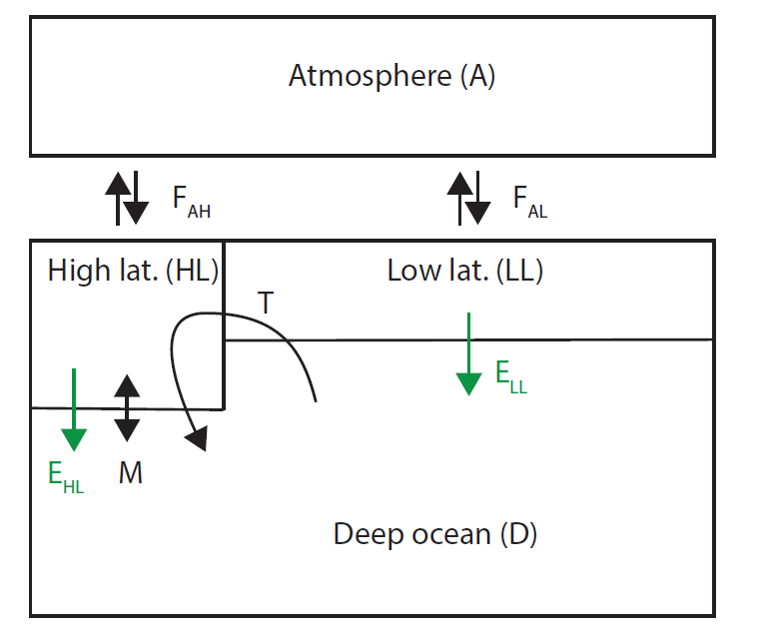
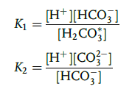
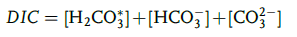
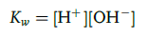
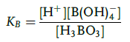
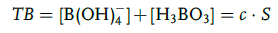
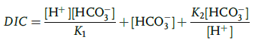
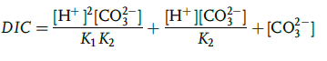
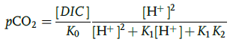
Do these pCO₂ variations explain by a change in the biological pump efficiency in the SO?
Solving for H⁺ knowing surface DIC and Alk (prescribed)
CO₂ flux = - K₀*K_{wind}*(ΔpCO₂)
N isotopes and nitrate concentration are included

Slide 3
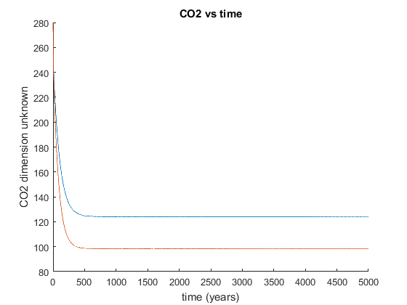
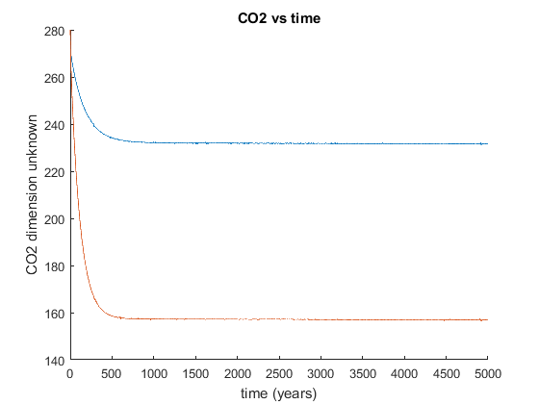
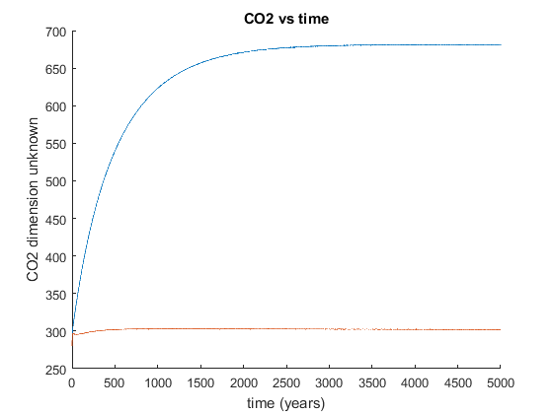
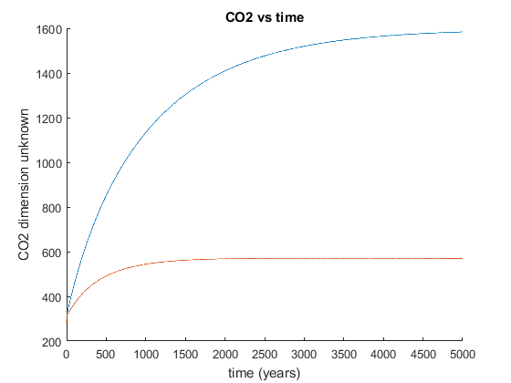
Surface Alk = 2500 µmol l⁻¹
Surface Alk = 2300 µmol l⁻¹
Surface Alk = 2150 µmol l⁻¹
Low SO biological pump efficiency
Atmospheric pCO₂
Atmospheric pCO₂
Atmospheric pCO₂
350ppmv
Atmospheric pCO₂
40ppmv
80ppmv
High SO biological pump efficiency
Surface Alk = 2050 µmol l⁻¹
SO degree of nutrient consumption = 0.2 or 1.0
1000ppmv
Atmospheric pCO₂
SO pCO₂ effect with degree of nutrient consumption $∝$ DIC/Alk

Slide 4
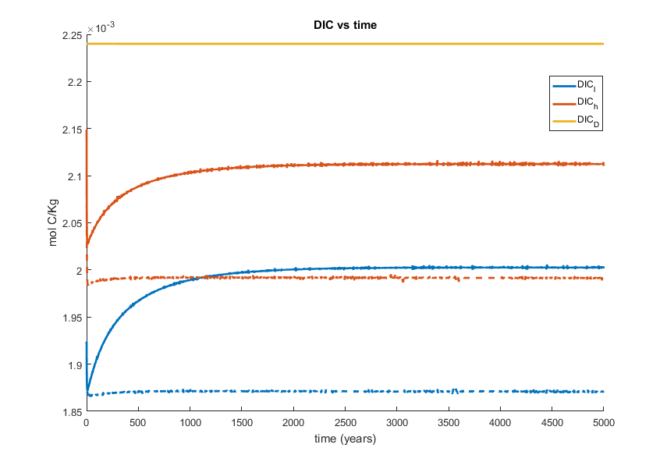
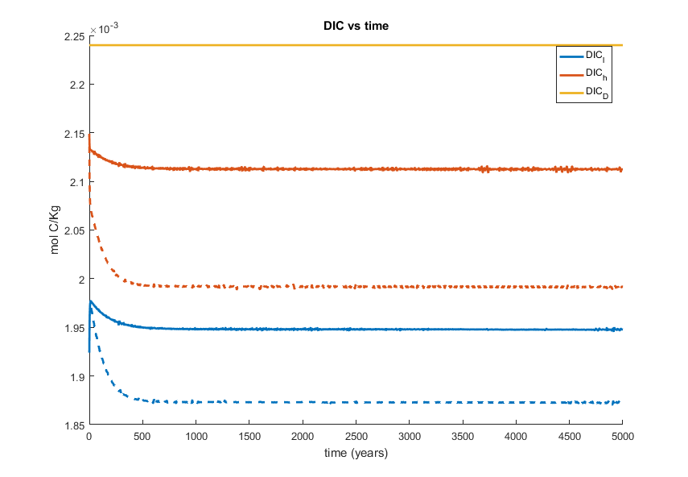
SO degree of nutrient consumption = 0.2 (solid) or 1.0 (dashed)
Prescribed surface alkalinity = 2150 µmol l-1
Prescribed surface alkalinity = 2300 µmol l-1
Deep
SO surface
Biological pump ↑
Biological pump ↑
DIC mol k-1
pCO2a↓
DIC mol k-1
T°C
pCO2a↓
LL surface
pCO2a↓ ↓ ↓
pCO2a↓
Full consumption scenario LL DIC = 1.87mM; Alk = 2.15mM; pH = 8.09
Partial consumption scenario HL DIC = 2.1mM; Alk = 2.15mM; pH = 7.8

Slide 5
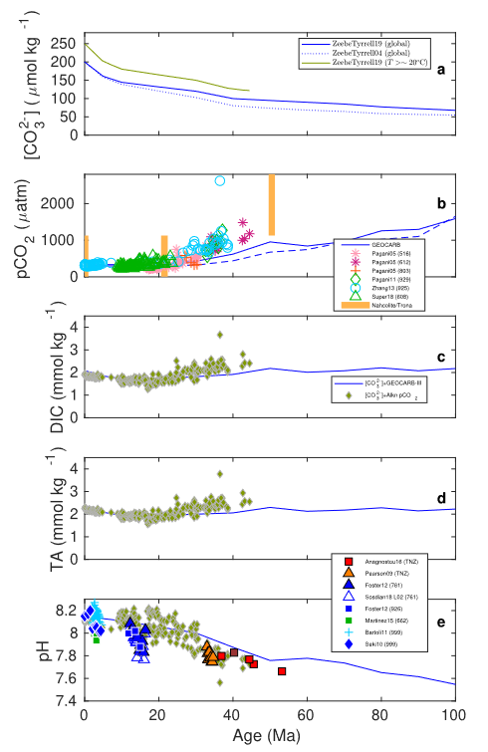
Stratification hypothesis
SO pCO2 effect
Stratification+nutrient
Nutrient hypothesis
Alk/DIC

Slide 6
